Slide 1
Swindon – Didcot – Oxford Connectivity Study
Study Update
www.englandseconomicheartland.com

Slide 2
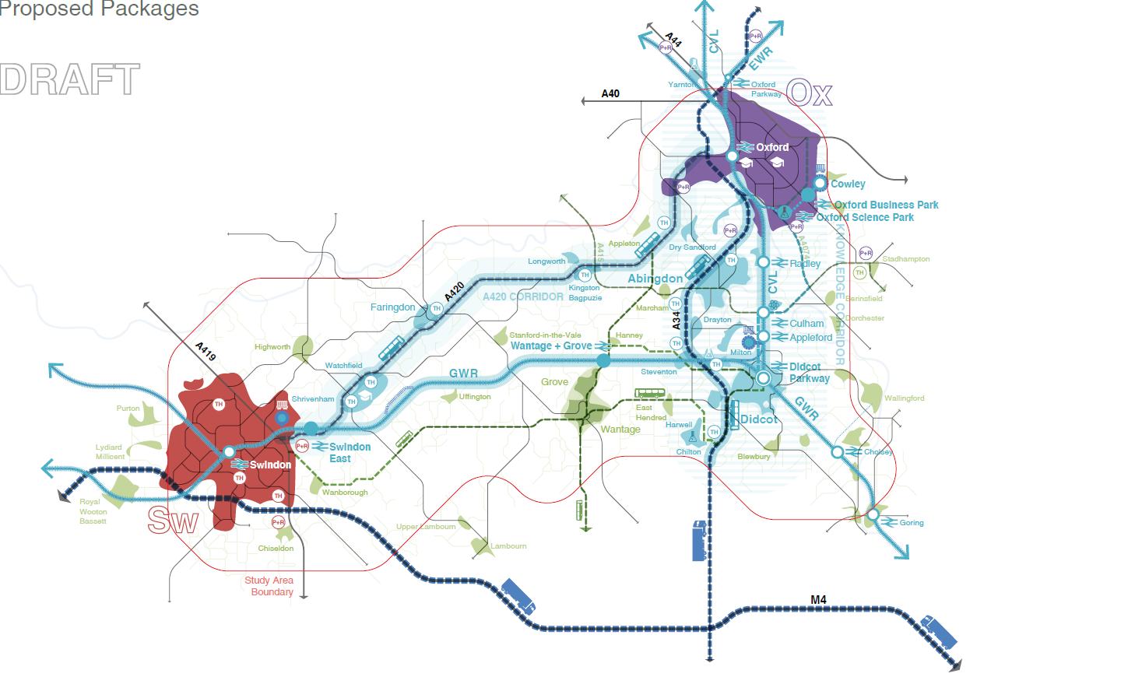
Purpose of the Connectivity Studies
The overall purpose of the connectivity studies
is to:​
Identify opportunities and solutions to maximise current and future connectivity in defined corridors or areas;
Build on the policy framework in the EEH Transport Strategy and will, in effect, provide a strategy for the area/ corridor to help achieve
the Transport Strategy vision
The studies are multi-modal, including digital

Slide 3
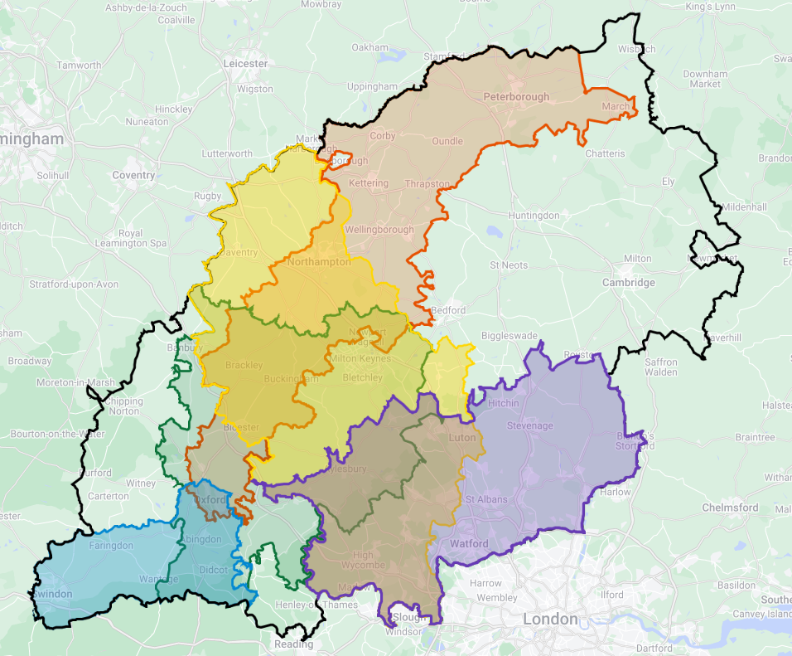
Overview of the Current Connectivity Study Programme
Study 1
Milton Keynes – Oxford – (Green - completed)
Study 2
Peterborough – Northampton – Oxford – (orange - completed)
Study 3
Swindon – Didcot – Oxford (Blue – in progress)
Study 4
Thames Valley – Buckinghamshire – Milton Keynes- Northampton (Yellow – in progress)
Study 5
Southern East West Movements (purple – in progress)
Study 6
Luton – Bedford – Corby (TBC)

Slide 4
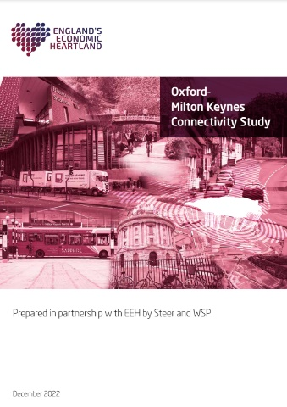
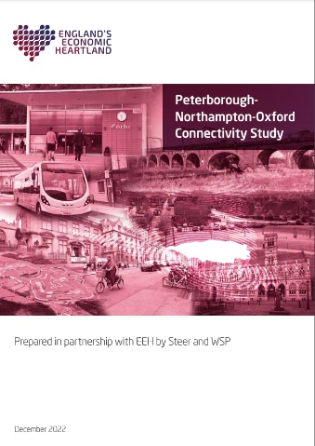
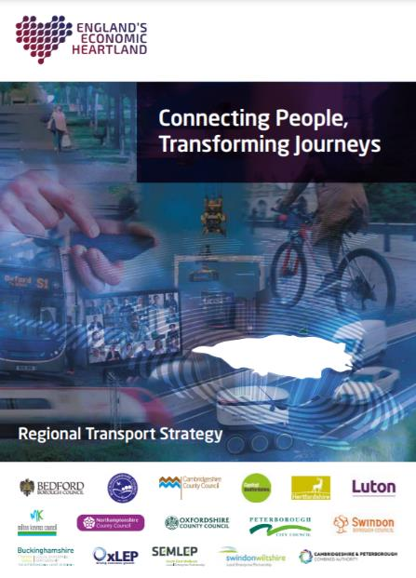
The studies link to delivering EEH’s Transport Strategy & investment pipeline
Connectivity Study Programme
Spring 2023
Technical Studies & other EEH activities
Transport Strategy
Study 1
Oxford – Milton Keynes
Study 2
Peterborough – Northampton – Oxford
Study 3
Swindon – Didcot – Oxford
Investment Pipeline
Early 2024
Early 2024
Still to be begin
Currently being developed
Study 4
Thames Valley – Buckinghamshire – Milton Keynes- Northampton
Study 5
Southern East West Movements
Study 6
Luton – Bedford – Corby
(TBC)

Slide 5
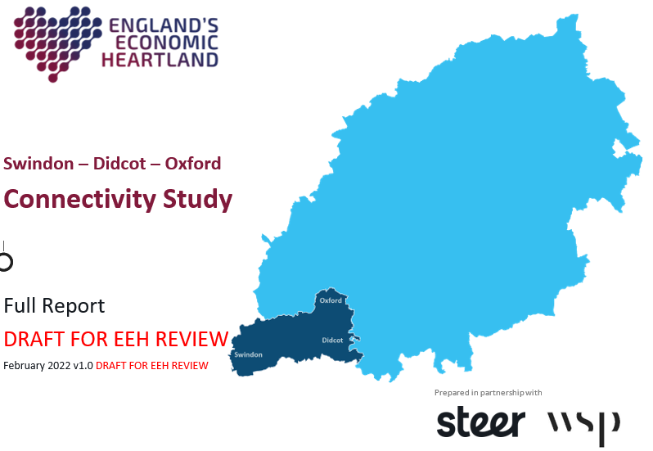
Project deliverables
Study evidence base
Call for evidence
Final report
We are currently drafting the final reports for the Swindon – Didcot – Oxford study. The report will be published following approval of the EEH Board in June.

Slide 6
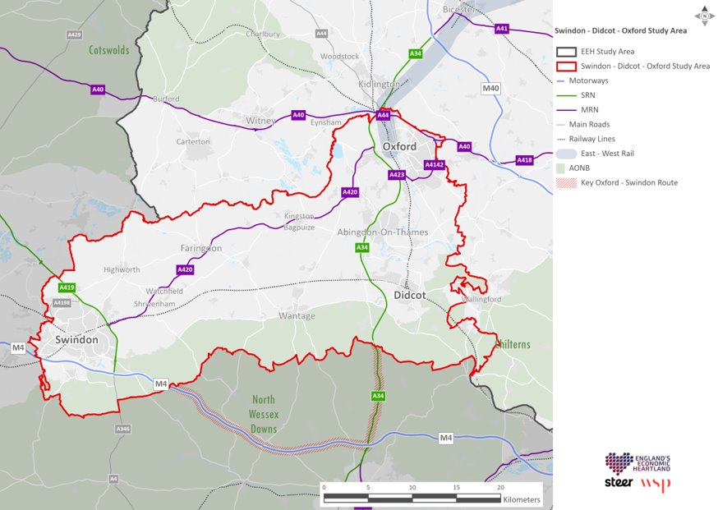
Swindon – Didcot – Oxford Study Area

Slide 7
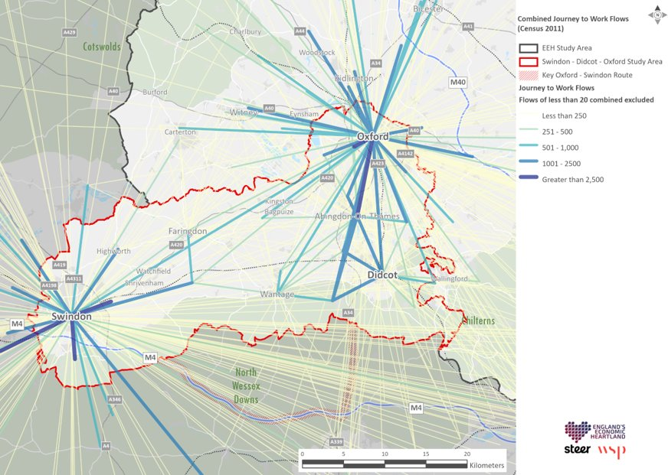
Swindon – Didcot – Oxford key movement

Slide 8
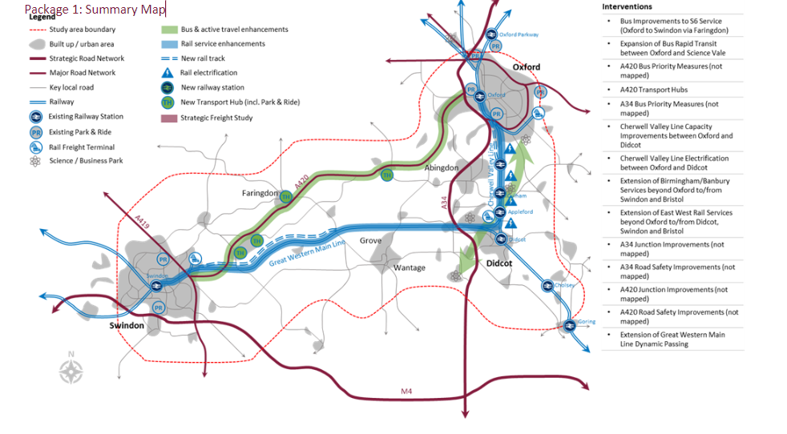
Draft Recommended Connectivity Plan

Slide 9
Draft packages Identified
Improved Inter-Urban Connections - Making the most of existing road and rail corridors with a particular focus on the A420 and A34, as well as electrification and extension of intercity rail services.
Reducing Congestion and Improving Sustainable Connectivity in Oxford Urban Area - Reducing car dependency in and around Oxford through improved active travel infrastructure, enhanced public transport services, and demand management
Reducing Congestion and Improving Sustainable Connectivity in Swindon Urban Area - Reducing car dependency in and around Swindon with logistics partnerships, improved active travel infrastructure, and enhanced public transport services.
Better Connecting Market Towns, Innovation Hubs, and Rural Areas - Reducing the number of unnecessary trips through improved digital connectivity, improving local roads and transport choice by making public transport more reliable and accessible.
Moving Freight More Effectively - Partnering with the private sector to reduce congestion caused by freight traffic, securing the future of regional freight terminals, and commissioning work to further understand local freight needs.
Creating a Sustainable Integrated Transport Network - Better integrating transport modes and reducing their overall cost and impact on the environment to encourage multi-modal journeys that more sustainably meet individual travel needs.
www.englandseconomicheartland.com

Slide 10
Next Steps
We are in the process of finalising the draft reports for the study
Following agreement of our partners and EEH Strategic Transport Leadership Board, the reports will be made available on the EEH website.
www.englandseconomicheartland.com

Slide 11
@EconomicHeart
Search ‘England’s Economic Heartland
www.englandseconomicheartland.com
Subscribe to our newsletter

