Slide 1
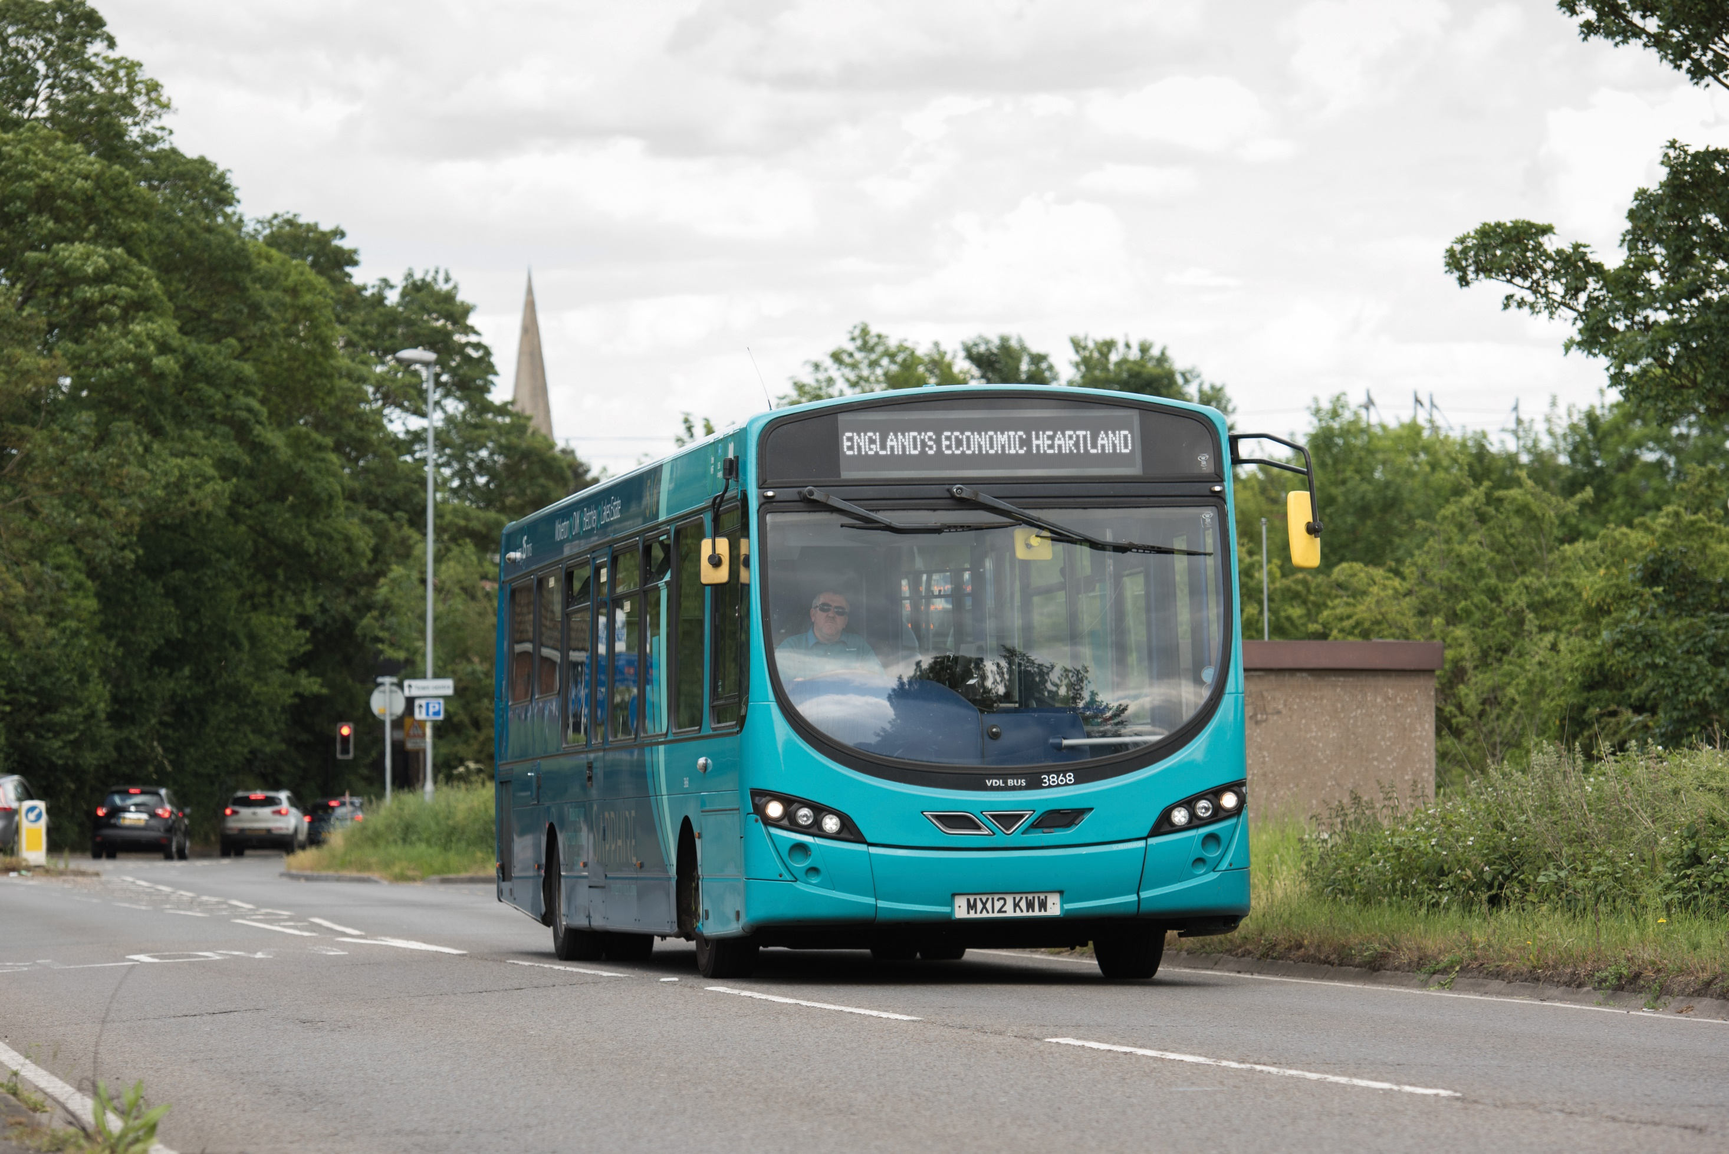
Bus Symposium 2023
‘Improving bus services in
England’s Economic Heartland’
www.englandseconomicheartland.com
Notes:
Roles for event:
Chair- Suzanne Winkels
Presenters- Trevor Brennan and James Gagg
Note taker: Everyone

Slide 2
Welcome
Cllr Liz Leffman,
Interim Chair of England’s Economic Heartland

Slide 3
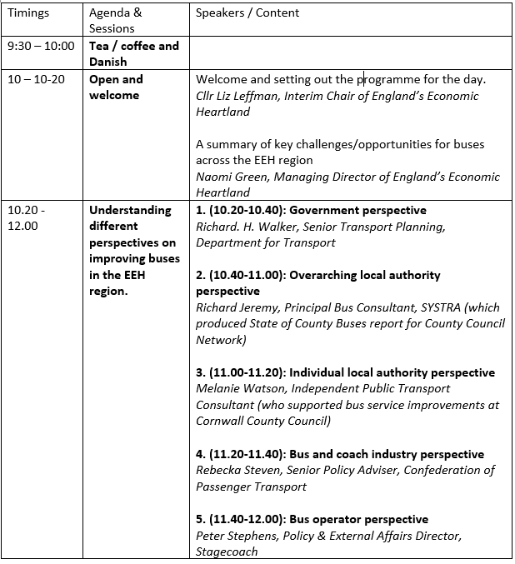
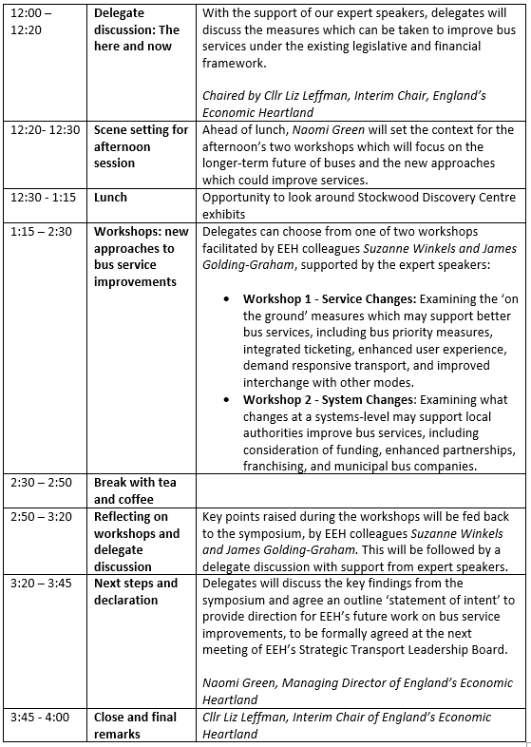
Outline of the day: Heartland Bus Symposium 2023

Slide 4
Setting the context for the EEH Bus Symposium
Naomi Green, Managing Director of England’s Economic Heartland

Slide 5
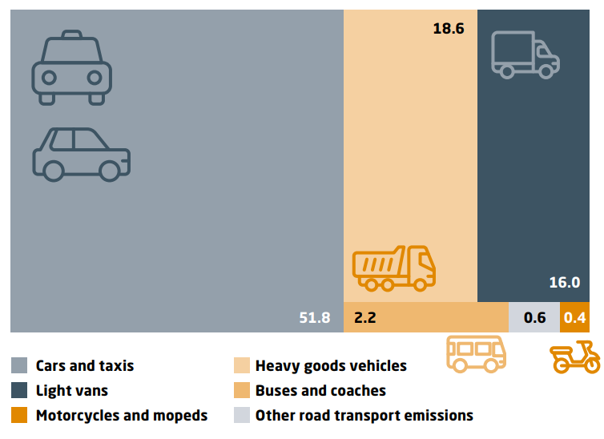
Policy context
Buses are the most common and realistic form of public transport, vital for meeting policy objectives around:
Net zero
Levelling-up
Rural connectivity
Economic growth
Access to services
Integration with other modes
The financial climate
Delivery of local transport plans
Carbon emissions by road transport type (UK)
“The wider social and economic benefits of local and regional bus services make it essential
that we continue to work … to create an accessible and future-ready bus network across the region.”
EEH Transport Strategy
Notes:
Bus services are critically important to the region
This recognised in EEH transport strategy
Critical for a number of reasons:
Net zero – reference graphic – buses are responsible for just 2.2% of road emissions, with cars and taxis responsible for more than half
Levelling-up – connecting people to jobs, often at a far more affordable way than car or train (especially now there is the fare cap)
Rural connectivity – rail is simply unrealistic for most of our rural areas
Access to services – whether its schools or hospitals or shops – used by people such as teenagers and pensioners who may not be able to drive
Integration – providing that first/ last mile connectivity to rail stations and transport hubs – for example crucial to success of EWR
Financial climate – again, with less money to spend, buses offer a realistic alternative to lots of expensive major infrastructure such as rail
Delivery of local transport plans – buses at the forefront

Slide 6
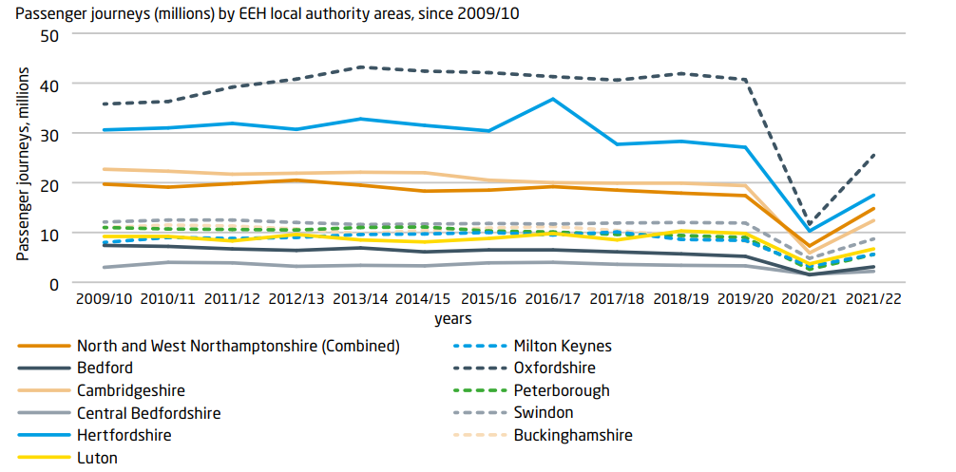
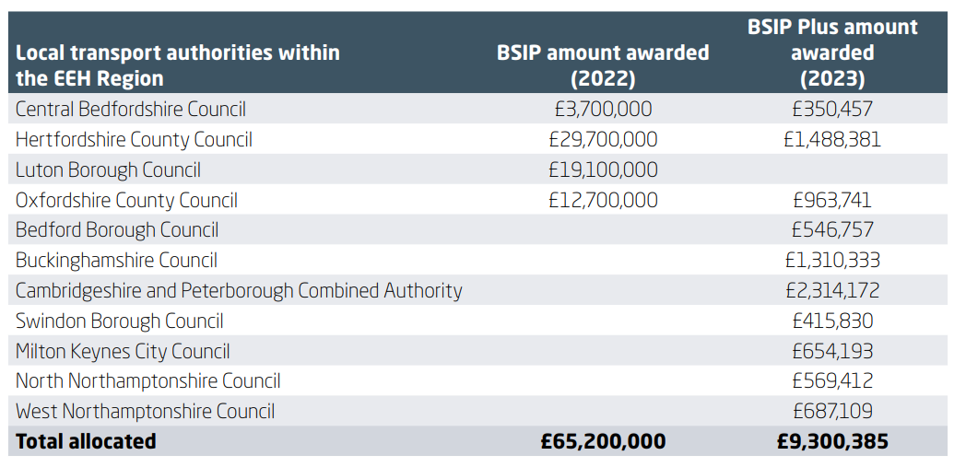
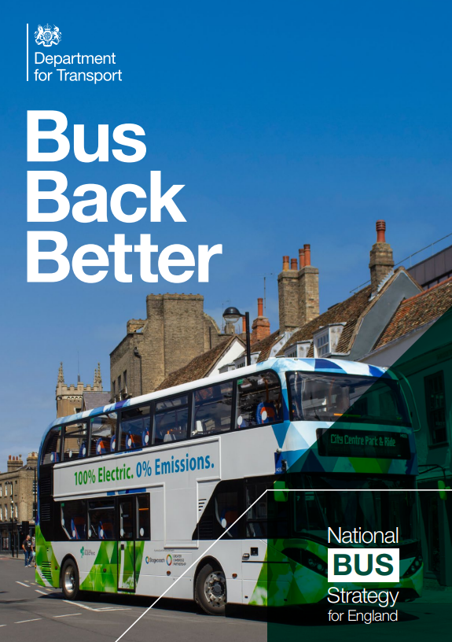
COVID-19 and
Bus Back Better
Bus patronage declined steeply during COVID-19 and is still down on pre-pandemic levels:
Government launched Bus Back Better in 2021 to help recover patronage
Local authorities asked to prepare bus service improvement plans for their areas
BSIPs have not been adequately funded by the government.
“This strategy will make buses more frequent, more reliable, easier to
understand and use, better co-ordinated and cheaper: in other words, more like London’s, where these type of improvements dramatically increased passenger numbers, reduced congestion, carbon and pollution, helped the disadvantaged and got motorists out of their cars.” Bus Back Better
Notes:
While patronage was on a slight decline prior to COVID, clearly the pandemic has had a devastating impact which we have not recovered
In response in 2021 we had Bus Back Better – very positive ambitions, finally placing buses front and centre of national transport policy. Very ambitious. Welcomed.
Local authorities asked to prepare BSIPs. However, only four out of 12 authorities received any money from the first tranche. Smaller amounts received by remaining authorities recently as part of BSIP plus. However, still fa short of the money which was being asked for. The County Council Network estimates that only 10% of the funding requested by its members was ultimately received.
As Buckinghamshire’s Cllr Steven Broadbent told the Transport Committee (prior to Bucks receiving its BSIP-plus): “The stark reality is that without additional funding we will be playing around the edge rather than creating a step-change.”

Slide 7
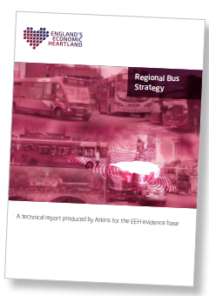
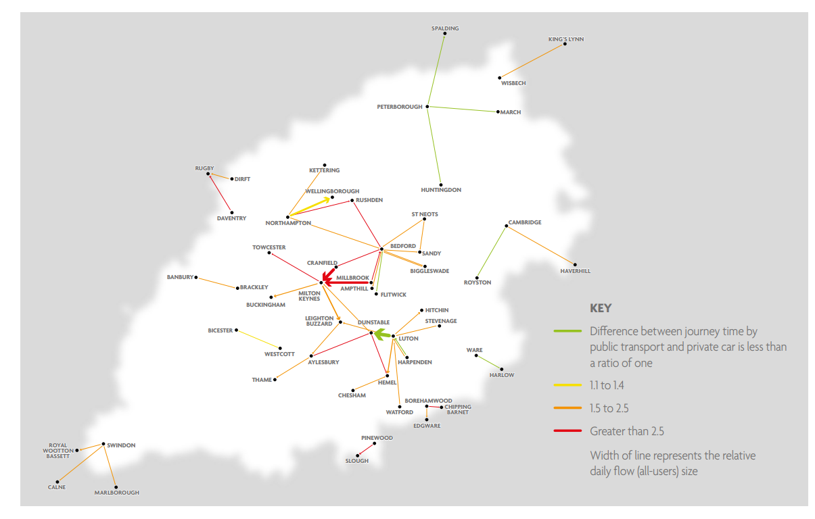
EEH’s Regional
Bus Strategy
The Bus Strategy’s ambitions:
More frequent and reliable services
Published in 2022, the strategy draws together the ambitions in our partners’ BSIPs to set a consistent regional vision.
Improvements to planning and integration with other modes
Improvements to fares and ticketing
Higher specification buses
Improvements to passenger engagement
The strategy also highlights opportunities for improved cross-boundary bus journeys by identifying high-movement corridors and comparing journey times by public transport versus car.
Decarbonisation
Notes:
EEH’s Regional Bus Strategy published in 2022.
It uses partners’ BSIPs as the basis for a regional vision for buses. It grouped together the key ambitions for bus journeys in the region which you can read on the right:
Using mobile data it also considered longer cross boundary journeys where there could be a strong market for improved bus travel. The research also showed the correlation between frequencies, speed and reliability – when you have this, as is the case with the Luton-Dunstable busway – you see very strong levels of patronage.

Slide 8
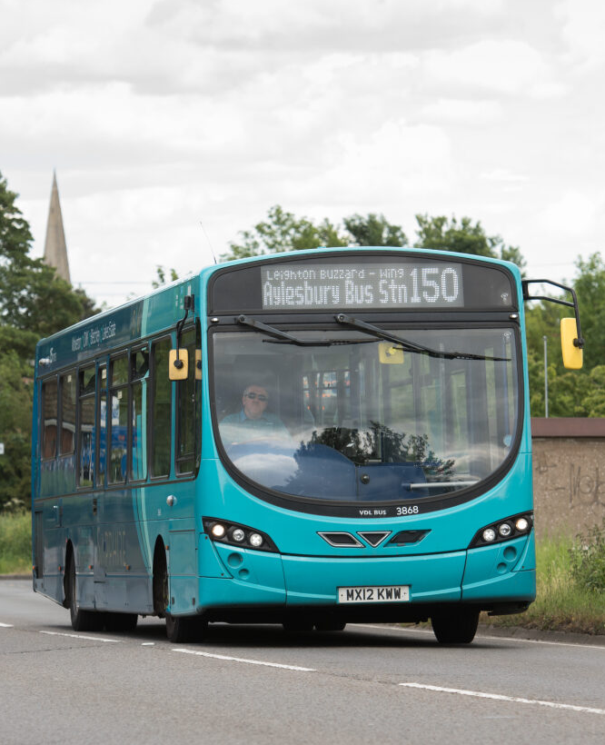
EEH’s further work on bus
Practical support: hosting officer workshops with support and advice from experts
Identifying inter-urban priorities: through our multimodal connectivity studies
Making mobility hubs a reality: through business case guidance, mapping tool and potential trialling
Bus funding bid booster: Calculating economic value of bus journeys for use in business cases (in development)
Attitudes survey: our survey of more than 7,000 people offers insight on what will get more people on buses
Notes:
The strategy had a number of recommendations and actions for further work which we are now delivering.
Practical support: Great feedback from officers. Recording of the webinars on our website.
Connectivity studies – identifying new bus corridors
Mobility hubs – fantastic reception to our business case guidance – now we’re looking to roll-out mobility hubs starting with a trial in the next year or so.
Bid booster – a new tool, currently in development, to calculate the economic value of bus
Survey – more than 7,000 people from the region, giving insight into why and why not – people are choosing to travel by bus.

Slide 9
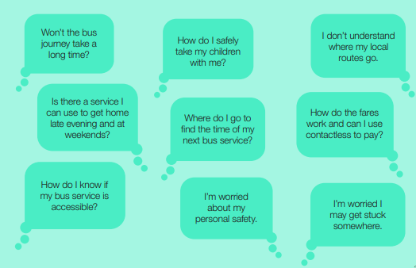
Improving services
Frequency
Reliability
Journey time
Route comprehensiveness
Easiness to understand
Easiness to use
Comfort and specification
Integration with other modes
Passenger safety
Contribution to net zero
Accessibility and inclusivity
Innovation
Our survey says…
Uncompetitive journey times are the biggest reason why people were put off from travelling by bus
Our survey says…
Only 5% of under 44s feel ‘nothing’ could make them use the bus more – but this was 20% for over 55s
Notes:
So the plan for today is to hear from our five experts. Get the information we need for both what we can do in the here and now and further into the future.
I think you can broadly put opportunities which we’ll hear about today to improve buses into two distinct categories: practical, on the ground measures which improve services.
And secondly changes to the actual system and models, which I’ll come onto on my next slide.
All of the bullet points here are from the Bus Back Better strategy – 12 factors which impact on the level of service provided by bus and therefore its attractiveness to potential passengers. Likewise the questions in the green box: “Can I get home in the evenings and weekends? I don’t understand the routes.”
These are all challenges which we will need to overcome to entice more people to use the bus.
It’s worth noting that EEH’s survey of 7,000 people showed that uncompetitive journey times as the biggest reason why people put off from travelling by bus. But the good news is that only 5% of under 44s said ‘nothing’ could entice them onto the bus – though this did rise to over 20% for the over 55s.

Slide 10
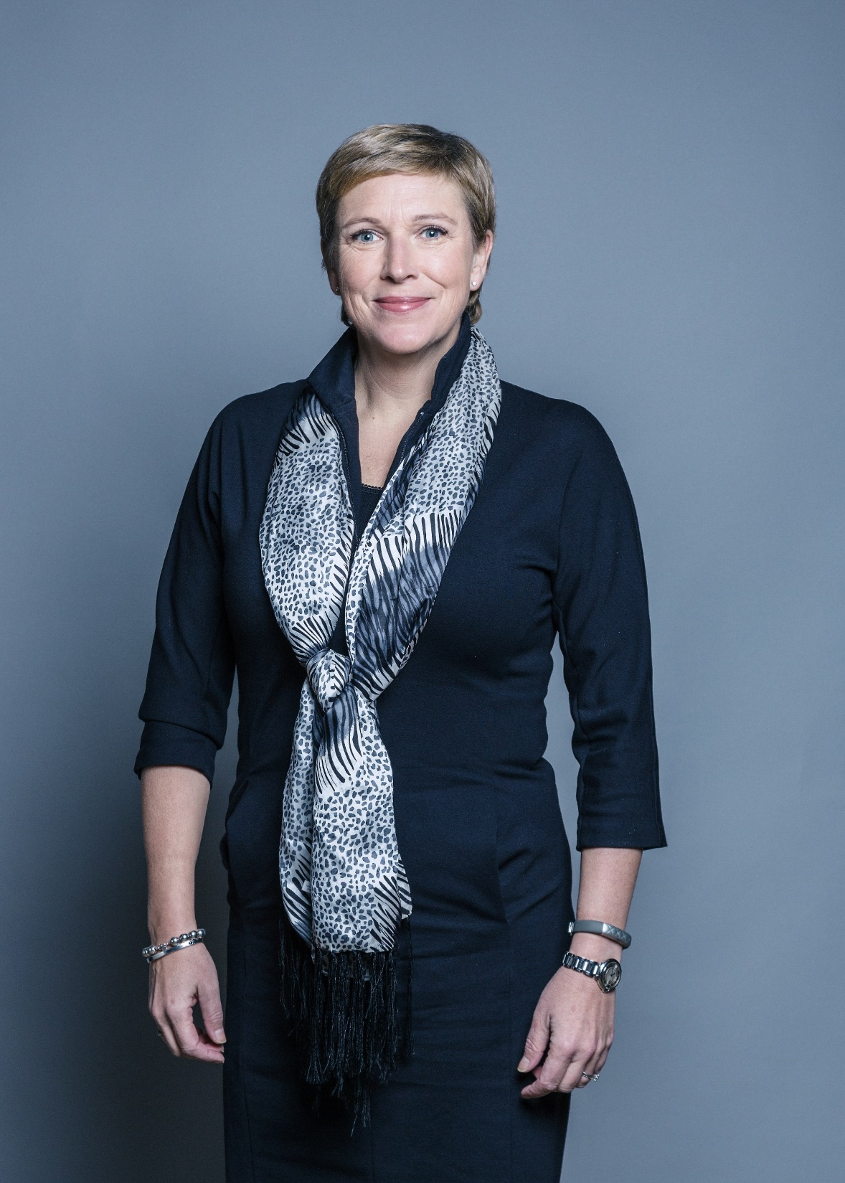
Change the system?
Enhanced Partnerships: The default position… but will they deliver transformational change?
Franchising: Allowing transport authorities to set bus service specifications… but is it afforable?
Municipal bus companies: They work in places such as Reading… but do they put taxpayers’ money at risk?
Funding: What is the future for the bus service operators grant… and will there be more BSIP funding?
“What we now need to ensure is that the local authorities recognise that they have a lot more power than they used to have, and they need to get the best outcomes for their local residents.”
Baroness Vere, Parliamentary
Under Secretary of State at the
Department for Transport
Did you know?
Government has committed to monitoring the impact of enhanced partnerships – which the transport committee said were ‘largely untested’
Notes:
Secondly, the symposium will no doubt be considering how the system and policy framework can work better for buses.
Currently enhanced partnerships are the default, and Baroness Vere has been clear that she believes they give local authorities considerable extra powers to improve bus services in their areas.
But what about franchising? Currently this is only available to mayoral combined authorities, but should that policy be relaxed? Likewise the ban on local authorities starting their own bus companies. And clearly, there are issues over funding – but in terms of BSIPs but also the bus service operators grant.
So I hope that provides useful context for the types of discussions we have ahead. I’ll now hand over to the Chair who will introduce the first of our five expert speakers. Thank you.

Slide 11
‘Understanding different perspectives on improving buses
in the EEH region’
Richard. H. Walker, Richard Jeremy, Melanie Watson,
Rebecka Steven and Peter Stephens

Slide 12
Government perspective
Richard. H. Walker,
Senior Transport Planning, Department for Transport

Slide 13
Overarching local authority perspective
Richard Jeremy, Principal Bus Consultant, SYSTRA

Slide 14
The State of County Buses - current and potential improvements
Richard Jeremy, Principal Bus Consultant

Slide 15
About myself
Twenty years’ experience in working on bus planning and delivery projects – in cities and counties
Experience in spatial development and net zero
Working in SYSTRA with a dedicated team of bus planners
Unique team background in bus industry and local transport authorities.
I’d like to send you home with some ideas for improving buses and increasing usage today.

Slide 16
The CCN’s study summary film

Slide 17
Key points from the report
Bus mileage has reduced by 25% in CCN areas since 2010
This decline was accelerated by COVID-19
CCN areas experienced the largest overall fall in passenger trips as a percentage (44%) since 2010
Commercial bus routes in fact had a small rise in trips from 2010 to COVID-19 onset, but their trip levels fell by 15% between 2019/20 and 2021/22
Elderly and concessionary pass trips have fallen faster in CCN areas since 2019 and have not recovered
A County Bus Strategy or Action Plan to recognise different needs of rural bus services is needed

Slide 18
Steps within current funding
Short-term: a behavioural science approach
Target timely moments and grab attention
Real-time passenger information for reassurance
Sharing LTA resources to reduce operational cost

Slide 19
Short-term: a behavioural science approach
Target timely moments. Make bus a noticeable and relevant choice
Simplify and personalise information. Make it easy to book and plan a multi-operator journey
Attract attention to information sources. Provide real-time information to all.
Provide a high-quality, clean, reliable journey experience
Repeat and settle new journey habits. Provide incentives and reminders to bus converts and users
School holidays - incentives?
High fuel prices – bus travel becomes cheaper than driving?
£2.00 single fare scheme?
Moving house?
Reasonable expectation early in an Enhanced Partnership

Slide 20
Target timely moments and grab attention
Launch a bus ticket discount scheme for the school holidays and weekends this autumn
Enhanced Partnerships, businesses and attractions collaborate on a regional bus user discount scheme
Publicise widely, e.g. MoneySavingExpert, media channels
Make sure people are aware of how to access journey planning information (council sites, GoogleMaps, bus stations) or who to ask
People experience bus travel for the first time and challenge their preconceptions
May consider change to using buses for work or school/college travel
Ensure that ideas are there for people with no spare budget!
Daddy, I’m bored!
Hmm… maybe I could take this bus to work?

Slide 21
Some half-term bus trips from a bus stop in Marlow
Roald Dahl Museum
Kew Little Pigs
Amersham Museum
Walks in the Chiltern Hills
The Hellfire Caves
Hughenden Manor
Bekonscot Model Village
Rush UK Trampoline Park
High Wycombe shops, restaurants, cinemas, Lido and Chair Museum
Rebellion Brewery (parents’ break time!)
Kenton Theatre, River and Rowing Museum, Henley events
High Wycombe leisure centre
Caversham Lakes
Reading shops, restaurants and cinemas
Under 30 mins
Under 1 hour
Under 90 mins

Slide 22
Real-time passenger information for reassurance
Generally rural bus services are not frequent
Reliability and punctuality of bus services is even more relevant than in a city environment.
Real-time passenger information gives reassurance and customer confidence.
The system in place must be reliable and up to date – a fault may create a bad memory that prevents them from re-using buses.
Many potential users in rural areas are less inclined to use app software
Bus passenger satisfaction at bus stop (existing users):
61% fairly or very satisfied with information
32% waited a little or a lot much longer than expected
(Transport Focus Bus Passenger Survey 2018, pre-COVID 19)
Ensure current systems are working properly and scope out future locations in rural areas!

Slide 23
Sharing LTA resources to reduce operational cost
On-demand Demand Responsive Transport (DRT) is a popular service, reaching new areas and attracting new public transport users
It is relatively expensive to run compared to the supported bus route it often replaces. DRT trials often end once the DfT or developer financing ends.
Sharing back-office functions between DRT / Community Transport / shared taxi-running LTAs means savings can be made in:
Customer service, staff training and systems maintenance
Tendering process
Licencing (shared-taxis)
Network planning and/or branding can remain at LTA level or be region-wide

Slide 24
Sharing LTA via Open Platform
Open Platform processes and software now mean easy integration of new operators, new modes, future MaaS and potentially Total Transport into the package.
With Open Platform systems, LTAs would not be locked into contracts with one DRT software firm.
Oxfordshire’s Shepherd system is a good example of an app and back-office – currently used for Oxfordshire’s school travel but can be diversified
Systra has experience in developing open standard procurement approaches, through our Bus Operations team and now Llewellyn Morgan, our Head of Innovation.

Slide 25
Measures within a future model of funding
Long-term funding arrangement from Government
Franchising provides a greater certainty of network
In-house operation may guarantee a presence of a bus operator in a rural area

Slide 26
Long-term funding arrangement with Government
Our case study councils revealed frustration at short-term funding.
Many projects receive excellent feedback from the public but finish after Government or private financing ends, causing frustration.
View that long-term financing for projects should be developed with councils and not dependent on bidding as at present.
Transition to long-term (5 year?) bus-dedicated funding system would allow better planning for the network.
Would also justify councils spending budget on future project plans to have ‘on-the-shelf’.
Very difficult for councils to commit limited budget to buses given other priorities, often legal ones for councils.
Need to ‘lock-in’ and provide bus subsidy from central government.

Slide 27
With a long-term funding formula, franchising buses in rural areas may be of benefit
LTA gains full control of the routes, service standards and branding.
Extensive requirement for procurement, legal, and planning staff.
Long-term, guaranteed income for bus operators, so less likely to withdraw.
Cost and farebox risks transfers to LTA. Risk of limited or no franchisee competition.
Greater control - not just DRT/supported services/Park & Ride
Important to know the objectives and budget:
is the aim to have greater quality control and certainty in operation?
is it a more ambitious fare-change and/or extending hours of operation?
What is the assessment criteria?
How will a monopoly local provider be avoided legally?

Slide 28
In-house operation may guarantee presence of a rural bus operator if good value operators leave
Political risk: would a council cover a future rural in-house operator’s loss?
A council spokesman said the principal reason for buying the company’s assets was to ensure the authority could continue to meet its statutory obligations, for schools transport in particular, and as an “invest to save” strategy. “In Pembrokeshire, there is very limited competition in the current market, having lost several operators over the last 10 years,” he added.

Slide 29
SYSTRA’s recommendations in the report
Support the delivery of Enhanced Partnerships and BSIP+ funding allocations
Government funding should be more transparent to LTAs about the criteria used to decide funding allocations
Government funding should move away from resource-heavy competitive bidding and find another way based on need
Government should commit to a long-term revenue funding settlement at the 2025 Spending Review
Government should make the fare cap permanent, amending it to a journey scheme similar to the London ‘Hopper’ fare, allowing one change on the trip
The franchising powers and processes on offer to Mayoral Combined Authorities should be made available to all Local Transport Authorities
Councils should consider the benefits of a regional approach to DRT
Government, operators and transport authorities should work to roll out the infrastructure required for Net Zero bus fleets

Slide 30
Thank you
Richard Jeremy - rjeremy@systra.com
Brian Drury - bdrury@systra.com

Slide 31
Individual local authority perspective
Melanie Watson, Independent Public Transport Consultant

Slide 32
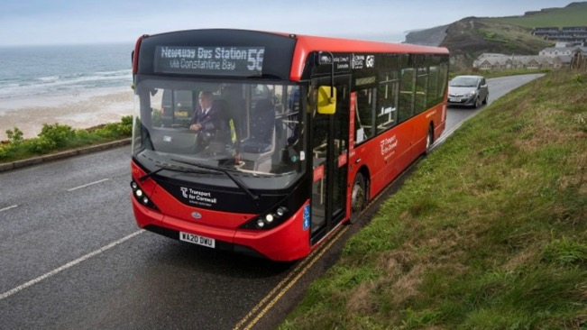
Rural Transport – One Public Transport System for Cornwall
Melanie Watson
Independent Consultant

Slide 33
Cornwall Context
Growing population, over half a million – 10% growth by 2031
25% population over 65 – compared to 18% for England & Wales, ageing at faster rate
2 in 5 people live in small settlements of less than 3,000 people - rural
Deep inequalities in health and wealth exist – low average salaries
Inequalities in health, education and safety outcomes between different groups of people and different places in Cornwall – some of which most deprived in UK
House prices around 9 times the average wage
Rural isolation is a key issue, especially for children and young people
Politically strong support for public transport, shown by significant investment in buses and rail over the last 8 years.

Slide 34
Building the foundations - rail
Rail Improvement Package
Station upgrades & dualling of the mainline
Truro – Falmouth branch line improvements
2017 Enhanced Maintenance Facility – to support the rolling stock required for service enhancements
2018 Upgraded Sleeper Service, including sleeper lounges
Mainline Service Improvements
Signalling enhancements
Additional rolling stock
West Cornwall multi-modal hub – St Erth
Created confidence, provided the public transport ‘spine’ on which to build upon

Slide 35
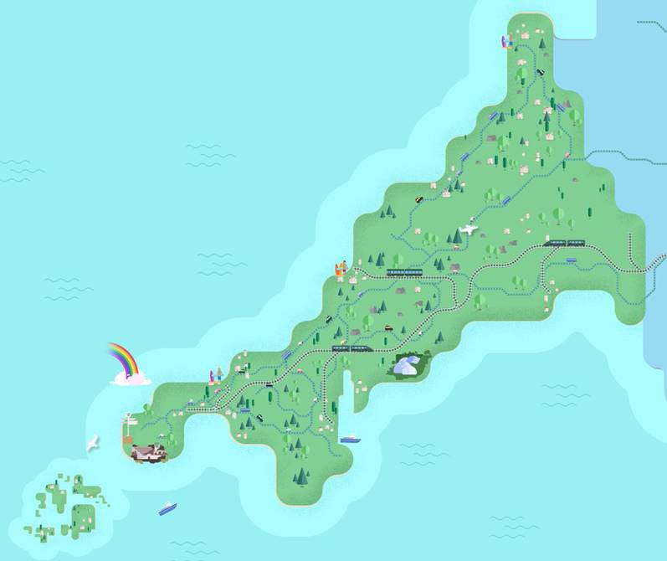
Devolution Deal 2015
Single transport ask = Bus Franchising
Devolution Deal 2015
£15m public transport investment
£35m+ Operator investment
Led to One Public Transport System for Cornwall
Voluntary Partnership with operators
New innovative tender

Slide 36
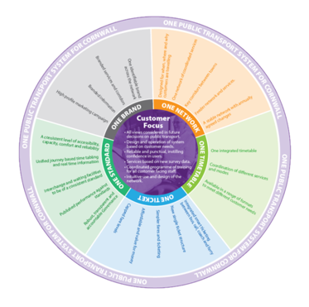
Integrated Vision
£15m+ investment to deliver
‘One Public Transport System for Cornwall’
Customer Focused
One Network
One Timetable
One Ticket
One Standard
One Brand
Aim was objective led, opportunity for operators to deliver against the vision.
In the background the Council undertook work to build the franchising case.

Slide 37
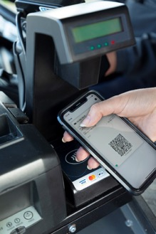
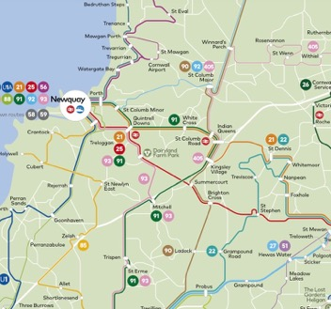
Bus – the building blocks
One integrated ticketing platform – delivered 2017 across the Cornwall bus fleet
Contactless ticketing and infrastructure investment 2018/19
Network Reviews – to consider the opportunities for growth. Note Cornwall subsidise around 50% mileage

Slide 38
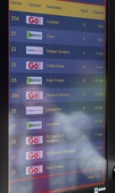
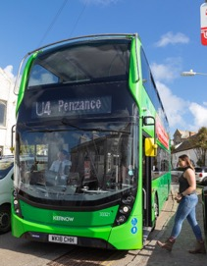
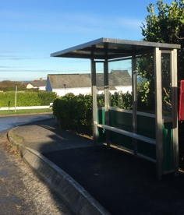
Bringing bus operators along
£35m+ operator investment in new buses, depot facilities and staff
Investment in passenger infrastructure and bus priority
Passenger Response
- 93% satisfaction
- 2% year on year growth – against decline in UK

Slide 39
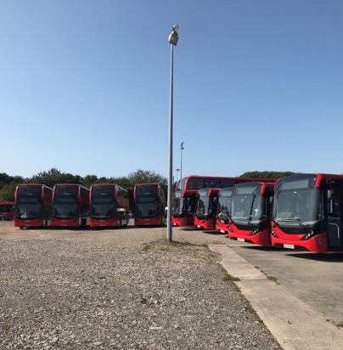
Long term investment – fleet & services
Innovative 8 year options tender - 2019
Ambitious Package bid agreed with Go Ahead for all tendered buses in Cornwall
Integrated commercial and tendered mileage to provide better links, more connections and upfront investment in a new fleet
Linked school journeys into the wider network to provide more cost effective mileage
Also includes delivery of one brand and customer service centre
102 new buses – delivered through Covid-19.
Best rural fleet in UK?

Slide 41
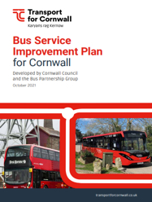
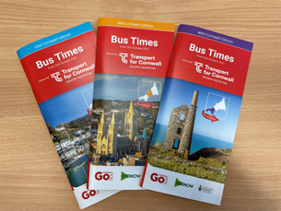
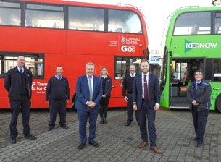
BSIP, Joint Information, Interoperability & Enhanced Partnership

Slide 42
Notes:
Richard
Video to introduce Step 2 – Interoperability of Tickets

Slide 43
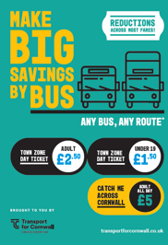
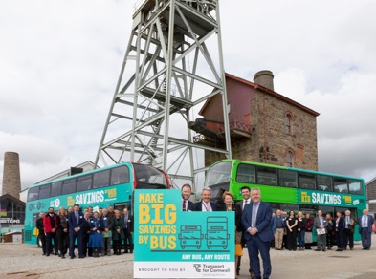
Bus Fares Pilot – Launched April 2022
April 2022 Make Big Savings by Bus launched
Reductions across most fares!
Simplification of single and return tickets
Cheaper £5 day ticket for travel across Cornwall
New town zones added in East Cornwall (over 10k pop.)
Huge marketing campaign deployed

Slide 44
What have we learnt?
No one size fits all – Cornwall building from a strong base
It needs a lot of investment – Cornwall subsidise 50% of the mileage, but benefits are real and wide ranging
Need to consider the ‘whole’ and how it fits together
Role of rail, school transport, CT, active travel, e-bike etc
DRT under review as part of wider network development
Have to accept some compromises and trade offs
School transport integration
Post-16 college flows
Need to understand journey patterns and prioritise some movements – create core public transport corridors
Network is key, but so is customer service and ticketing – needs to be seamless and reduce barriers
More work needed around interchange – we can’t provide direct journeys for all
Customers need consistent bus reliability and value convenience, speed and control over their journeys.

Slide 45
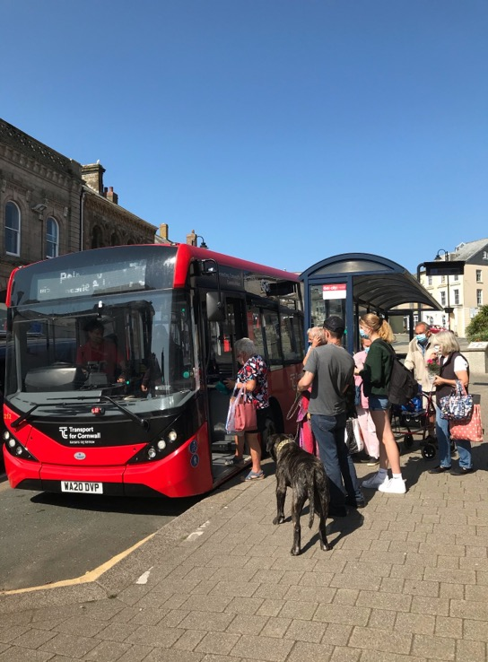
Passengers are returning – they are at the heart of our thinking. Transport provides a lifeline and changes lives!

Slide 46
Thank you
Melanie Watson
mwassociatespts@gmail.com
Nigel Blackler
nigel.blackler@scilly.gov.uk

Slide 47
Bus and coach industry perspective
Rebecka Steven, Senior Policy Adviser, Confederation of Passenger Transport

Slide 48
Improving buses in the EEH region – bus industry perspective Rebecka Steven Senior Policy Adviser, CPT rebecka.steven@cpt-uk.org

Slide 49
Funding
Even with emergency Covid support, funding was lower in real terms during the pandemic than a decade previously.
Source: DfT Bus Statistics table Bus0502b

Slide 50
What’s driven the change in rural mileage?
Supported mileage down 55%, commercial mileage up 3%
Supported mileage down 62%, commercial mileage up 11%
Source: DfT Bus Statistics BUS02A_mi
Notes:
Decade immediately before pandemic LTA supported mileage more than halved, commercial mileage has actually gone up.
Same period saw 11% decline in pax.

Slide 51
Certainty of funding can drive better outcomes
Increased bus funding to support services
Reformed concessionary reimbursement
Investment through BSIPs:
Improved journey times
Targeted fares initiatives
Local marketing
Reducing need for public expenditure
Faster, more frequent buses to more places
More routes are commercial
More passengers, more fare revenue, lower costs
Solutions for delivering bus services in hard to reach/left behind areas - CPT wants to work with government on this and willing to lead some taskforce-style work
Support for investment in Zero Emission Buses and infrastructure

Slide 52
The current situation
Forecast passenger demand by reason for travel 2022/23
Factors facing LTAs and operators
Service levels: currently operating at around 80-85% of passenger numbers compared to pre-pandemic levels.
Passenger demand compared to pre-pandemic levels:
Fare-paying passengers – 85%
Concessionary passengers – 72%
A change in what people use buses for: Commuting, business and shopping now make up a smaller percentage of journeys
Cost changes: Inflation across the sector is currently 17%
Driver shortages

Slide 53
Reasons for not using local buses
Moving faster
Clear pricing
Complementary measures on cars
Source: Transport Focus, Motivations and barriers to bus usage

Slide 54
The Challenges Ahead
Market recovery
Winning passengers back
Short term sustainability
Getting back to viability
The Zero Emissions Path
Funding the investment
Getting whole life costs down
Modal Shift
Meeting net zero targets
Slide courtesy of Chris Cheek / Passenger Transport Monitor

Slide 55
5 keys to success
Brilliant buses, every time
More buses
Faster buses
Clear pricing
Complementary action on cars

Slide 56
Regulation
Regardless of the regulatory model in place, EP or franchising – the same issues remain:
Congestion must be tackled by LTAs introducing bus priority measures and putting bus first on roads
This will mean shorter journey times, increasing passenger numbers and therefore revenue will increase
More routes will become commercially viable and less funding will be required in the long term.

Slide 57
Thank you

Slide 58
A bus operator perspective
Peter Stephens,
Policy & External Affairs Director

Slide 59
A bus operator perspective
Peter Stephens,
Policy & External Affairs Director
15th September 2023

Slide 60
Current commercial position
Inter-urban routes
Commercially sustainable; some scope to support local networks
Local town networks
Mixed picture; impact of other policies (e.g. parking)
Hub-and-spoke services
Health depends on time-bound demand (e.g. commuting, schools); role of bus priority
‘Village hopper’ services
Most challenging; many already supported

Slide 61
Why do rural bus services matter?
The health and community benefits of social inclusion
The economic benefits of accessing goods and services
The public policy benefits of improving delivery of public services
See public transport in wider service delivery context
The sense of identity and vibrancy for a local community
Recognise as ‘Critical Local Infrastructure’
The network effect of improving public transport interconnection
Capture network externalities in investment case analysis

Slide 62
Managing the cost base
Labour costs (52%): rural recruitment challenges
Smaller labour pool with greater competition
High cost of living in many rural areas
Policies to support local labour markets
Running costs (19%): longer rural routes
Increased fuel & parts costs
Introduction of BSOG+; BSOG reform
Depreciation (8%): cascaded vehicles on rural routes
Depreciation costs of vehicle investment

Slide 63
Optimising operating revenue
Commercial revenue: stimulation and better aggregation of transport demand
Better marketing and signposting of services (e.g. through hospitals and schools)
Shared transport data analysis to identify untapped demand opportunities
‘Total Transport’ funding approach – s106, NEPT, home-to-school, private provision
Concessionary revenue: reduced churn on rural services; different generation?
Reflect rural specifics in reimbursement
Revision of the reimbursement calculator/guidance
Other revenue: potential to identify new revenue streams?

Slide 64
Some immediate actions
Greater sharing of data and analysis to identify potential untapped demand
Look at the end-to-end journey, not just the bus element
Better signposting of existing public transport provision
Accurately capturing externalities in investment case analysis
Developing local transport partnerships to develop Total Transport funding
Not talked about governance changes or DRT – same challenges persist

Slide 65
Delegate discussion: The here and now
Chaired by Cllr Liz Leffman, Interim Chair, England’s Economic Heartland

Slide 66
Scene setting for afternoon session
Naomi Green, Managing Director of England’s Economic Heartland

Slide 67
Bus Symposium 2023
Lunch
www.englandseconomicheartland.com
Notes:
Roles for event:
Chair- Suzanne Winkels
Presenters- Trevor Brennan and James Gagg
Note taker: Everyone

Slide 68
‘New approaches to bus service improvements’
Workshop 1 - Service Changes: Examining the ‘on the ground’ measures which may support better bus services
Workshop 2 - System Changes: Examining what changes at a systems-level may support local authorities improve bus services

Slide 69
Bus Symposium 2023
Break
www.englandseconomicheartland.com
Notes:
Roles for event:
Chair- Suzanne Winkels
Presenters- Trevor Brennan and James Gagg
Note taker: Everyone

Slide 70
Reflecting on workshops and delegate discussion
Suzanne Winkels and James Golding-Graham, EEH

Slide 71
Next steps and declaration
Naomi Green
Managing Director of England’s Economic Heartland

Slide 72
Close and final remarks
Cllr Liz Leffman
Interim Chair of England’s Economic Heartland

Slide 73
@EconomicHeart
Search ‘England’s Economic Heartland’
www.englandseconomicheartland.com
Subscribe to our newsletter

